Slide 1
Australian Football International Cup
Author is Stolyarowa Elizaveta, 10A

Slide 2

Australian Football is a contact sport played between two teams of 18 players on an oval field. Points are scored by kicking the oval ball between the middle goal post (worth six points) or between a goal and behind post (worth one point).

Slide 3

Australian Football International Cup is an international sport competition in Australian rules football, at this time in this event contested by amateur players only. It pass has been every three years since 2002.

Slide 4

Earlier International Australian Football Council thought that 2008 was the appropriate date for spending an official World Cup of Australian Football.

Slide 5

However, in 1999 a proposal was received from the New Zealand Australian Football League suggesting that the World Cup be brought forward to 2002, which was accepted.

Slide 6
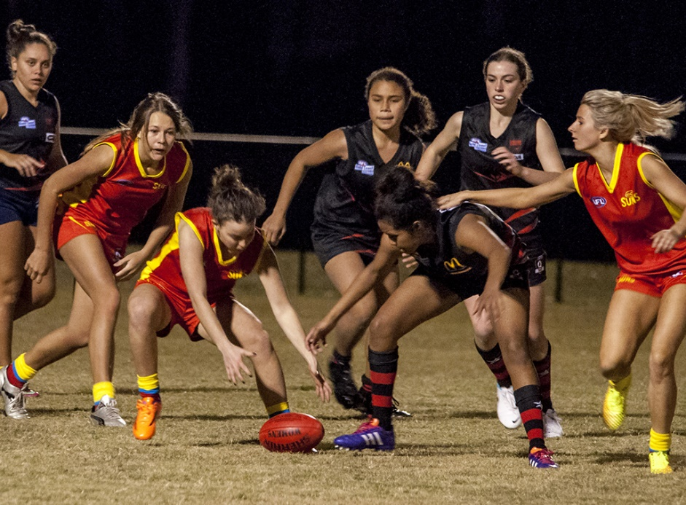
The Cup was originally for male participants only, but in 2011 a women's competition was established.

Slide 7

The 2020 International Cup was postponed until 2021, due to the COVID-19 pandemic.

Slide 8
Thank you for you attention!

